Slide 1

2020
Hsinchu x MeiChu Hackathon
Team: 726戰隊
Members: Howard Wang, Daniel Chen, Jack Liu, Leo Hsieh, Bowen Lee

Slide 2

Topic
Logitech International:
Ethical gaming world

Slide 3
Problems to solve
Ways to cheat on games
Privacy concern
Sometimes I want to have fun!
Application on various games

Slide 4
Hardware Detection
Mouse G502
Keyboard G815

Slide 5
Can our machine learn a gamer’s bahavior?

Slide 6
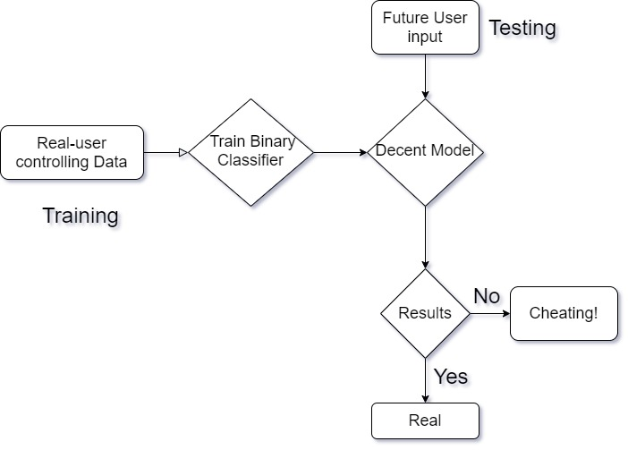

Slide 7
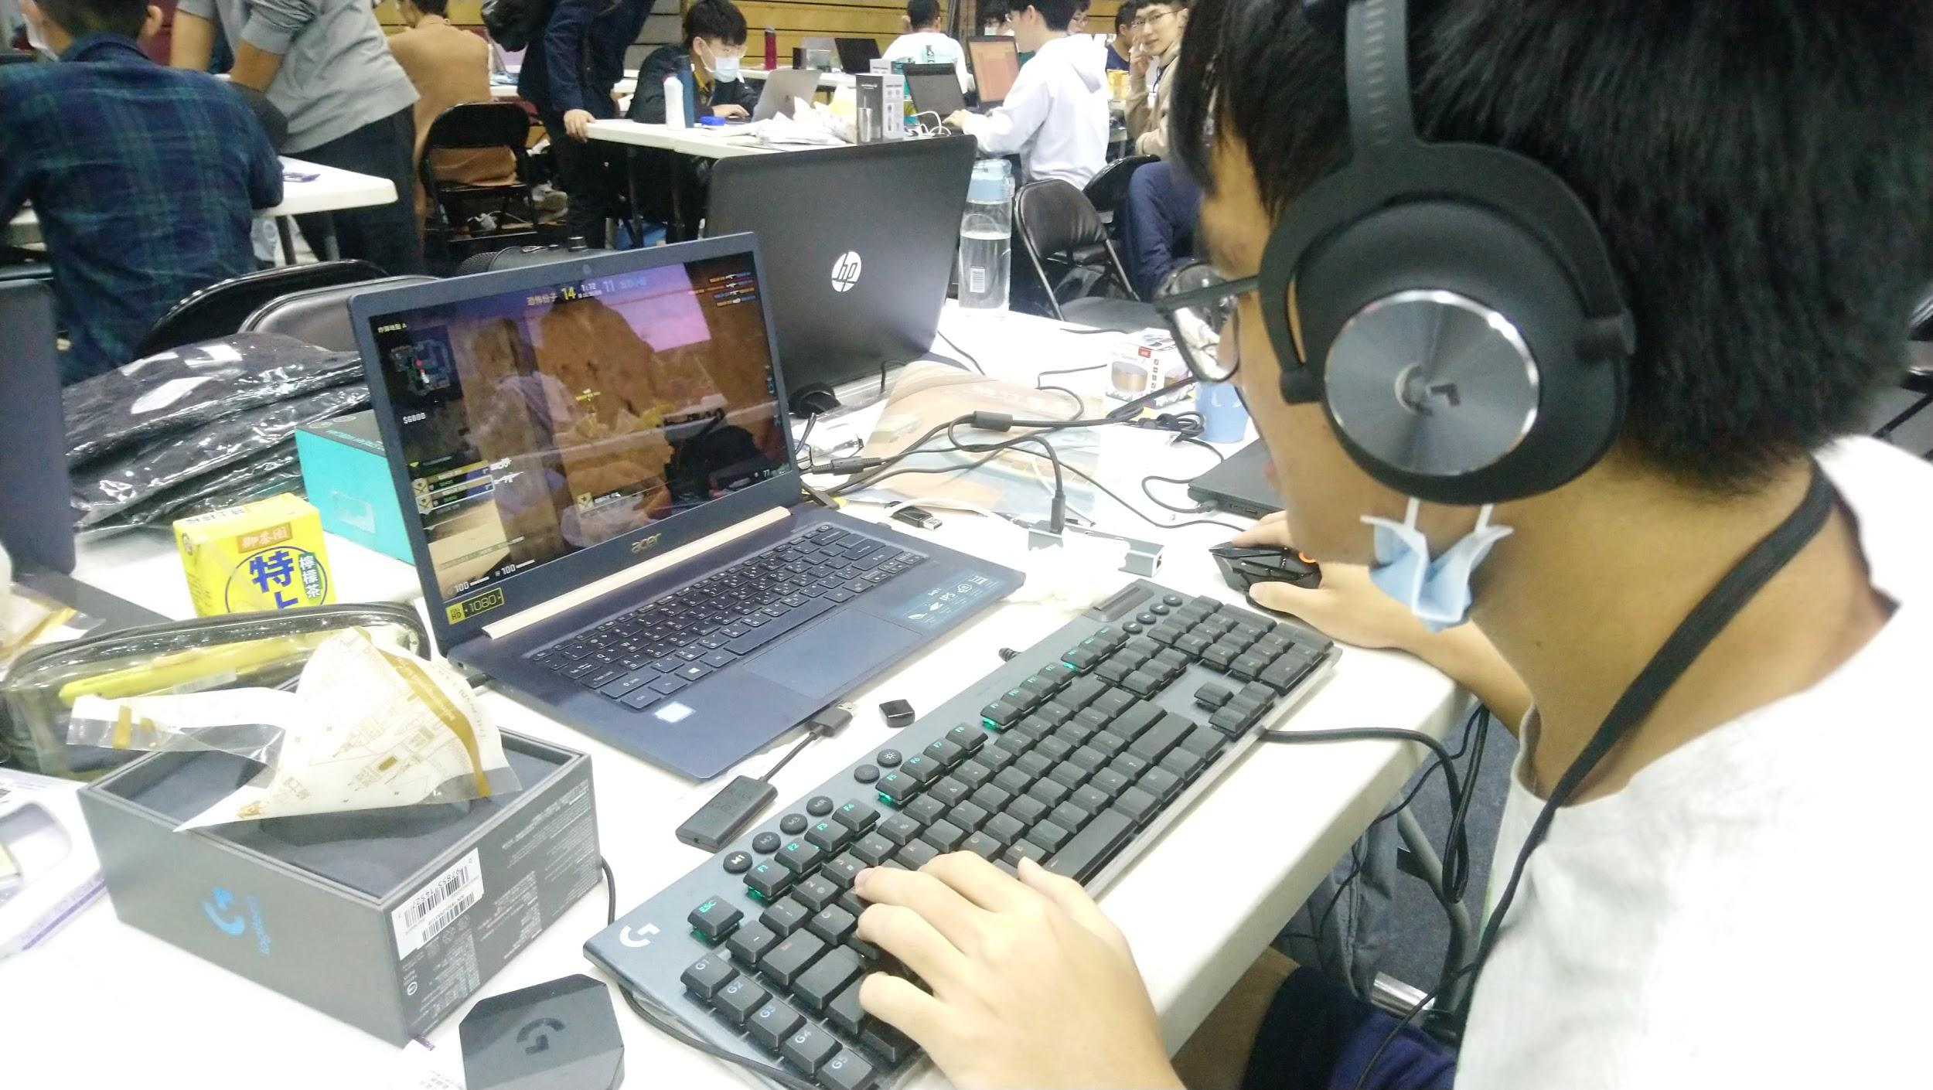
Collection Process
Detect the input from mouse and keyboard using Python.

Slide 8
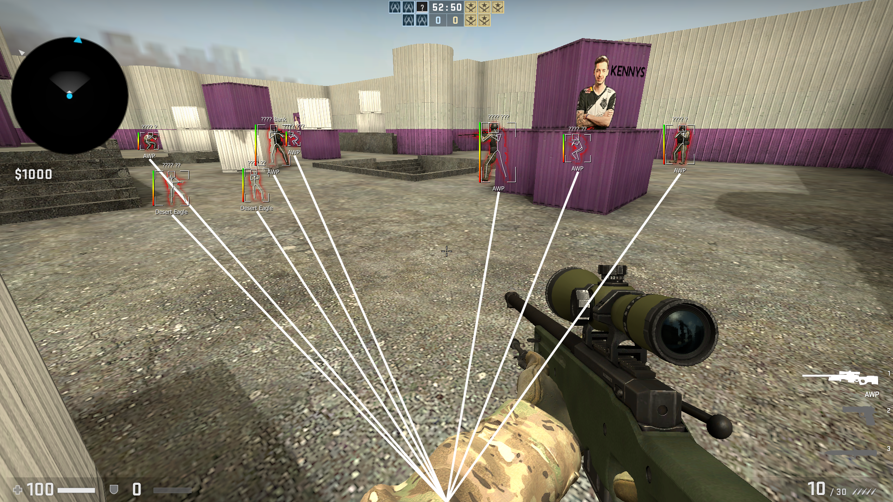

Slide 9
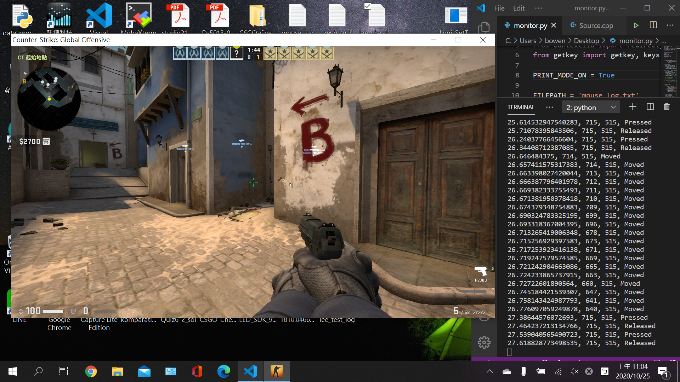

Slide 10
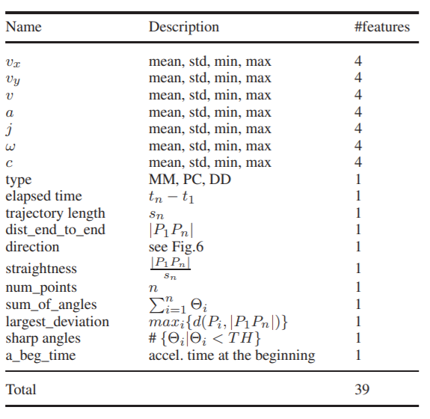

Slide 11
Technical Details
Data Collect: Python(pynput)
Model: Random Forest
Game: CS-GO
Gaming hack: Auto Aim(open source), Booster, AFK

Slide 12
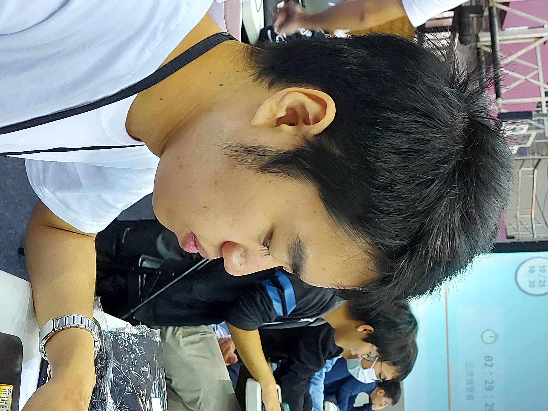
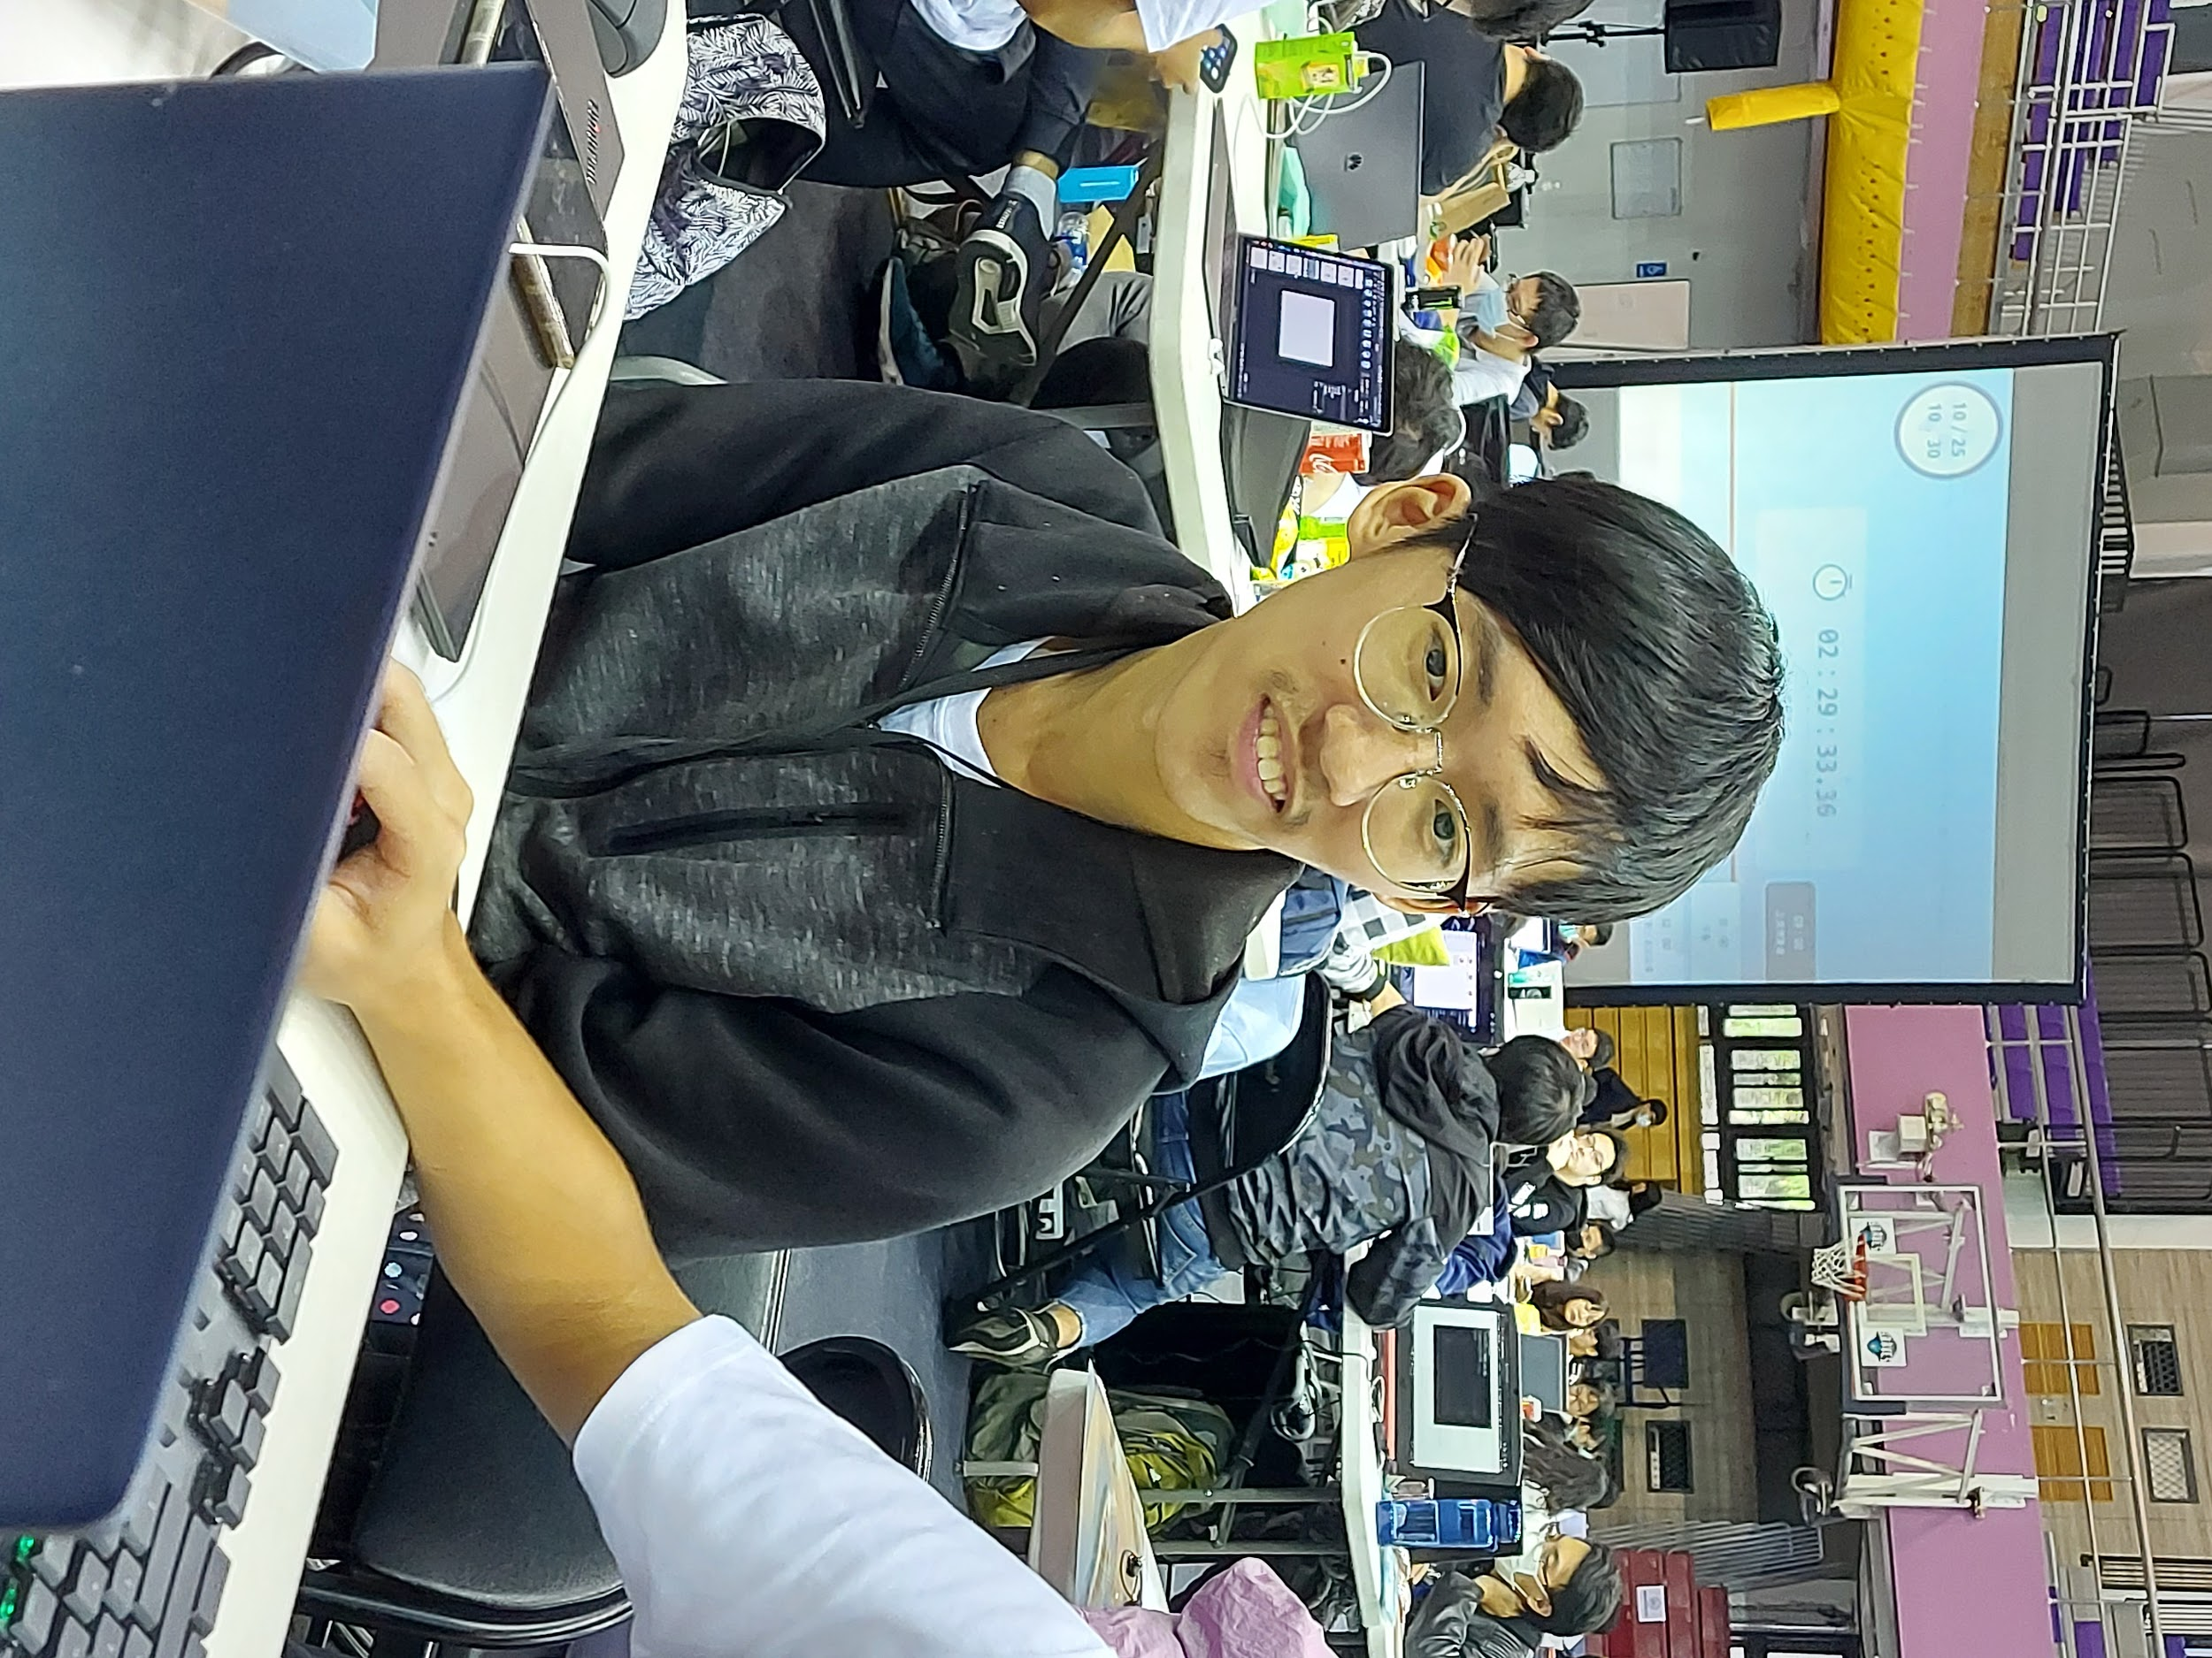
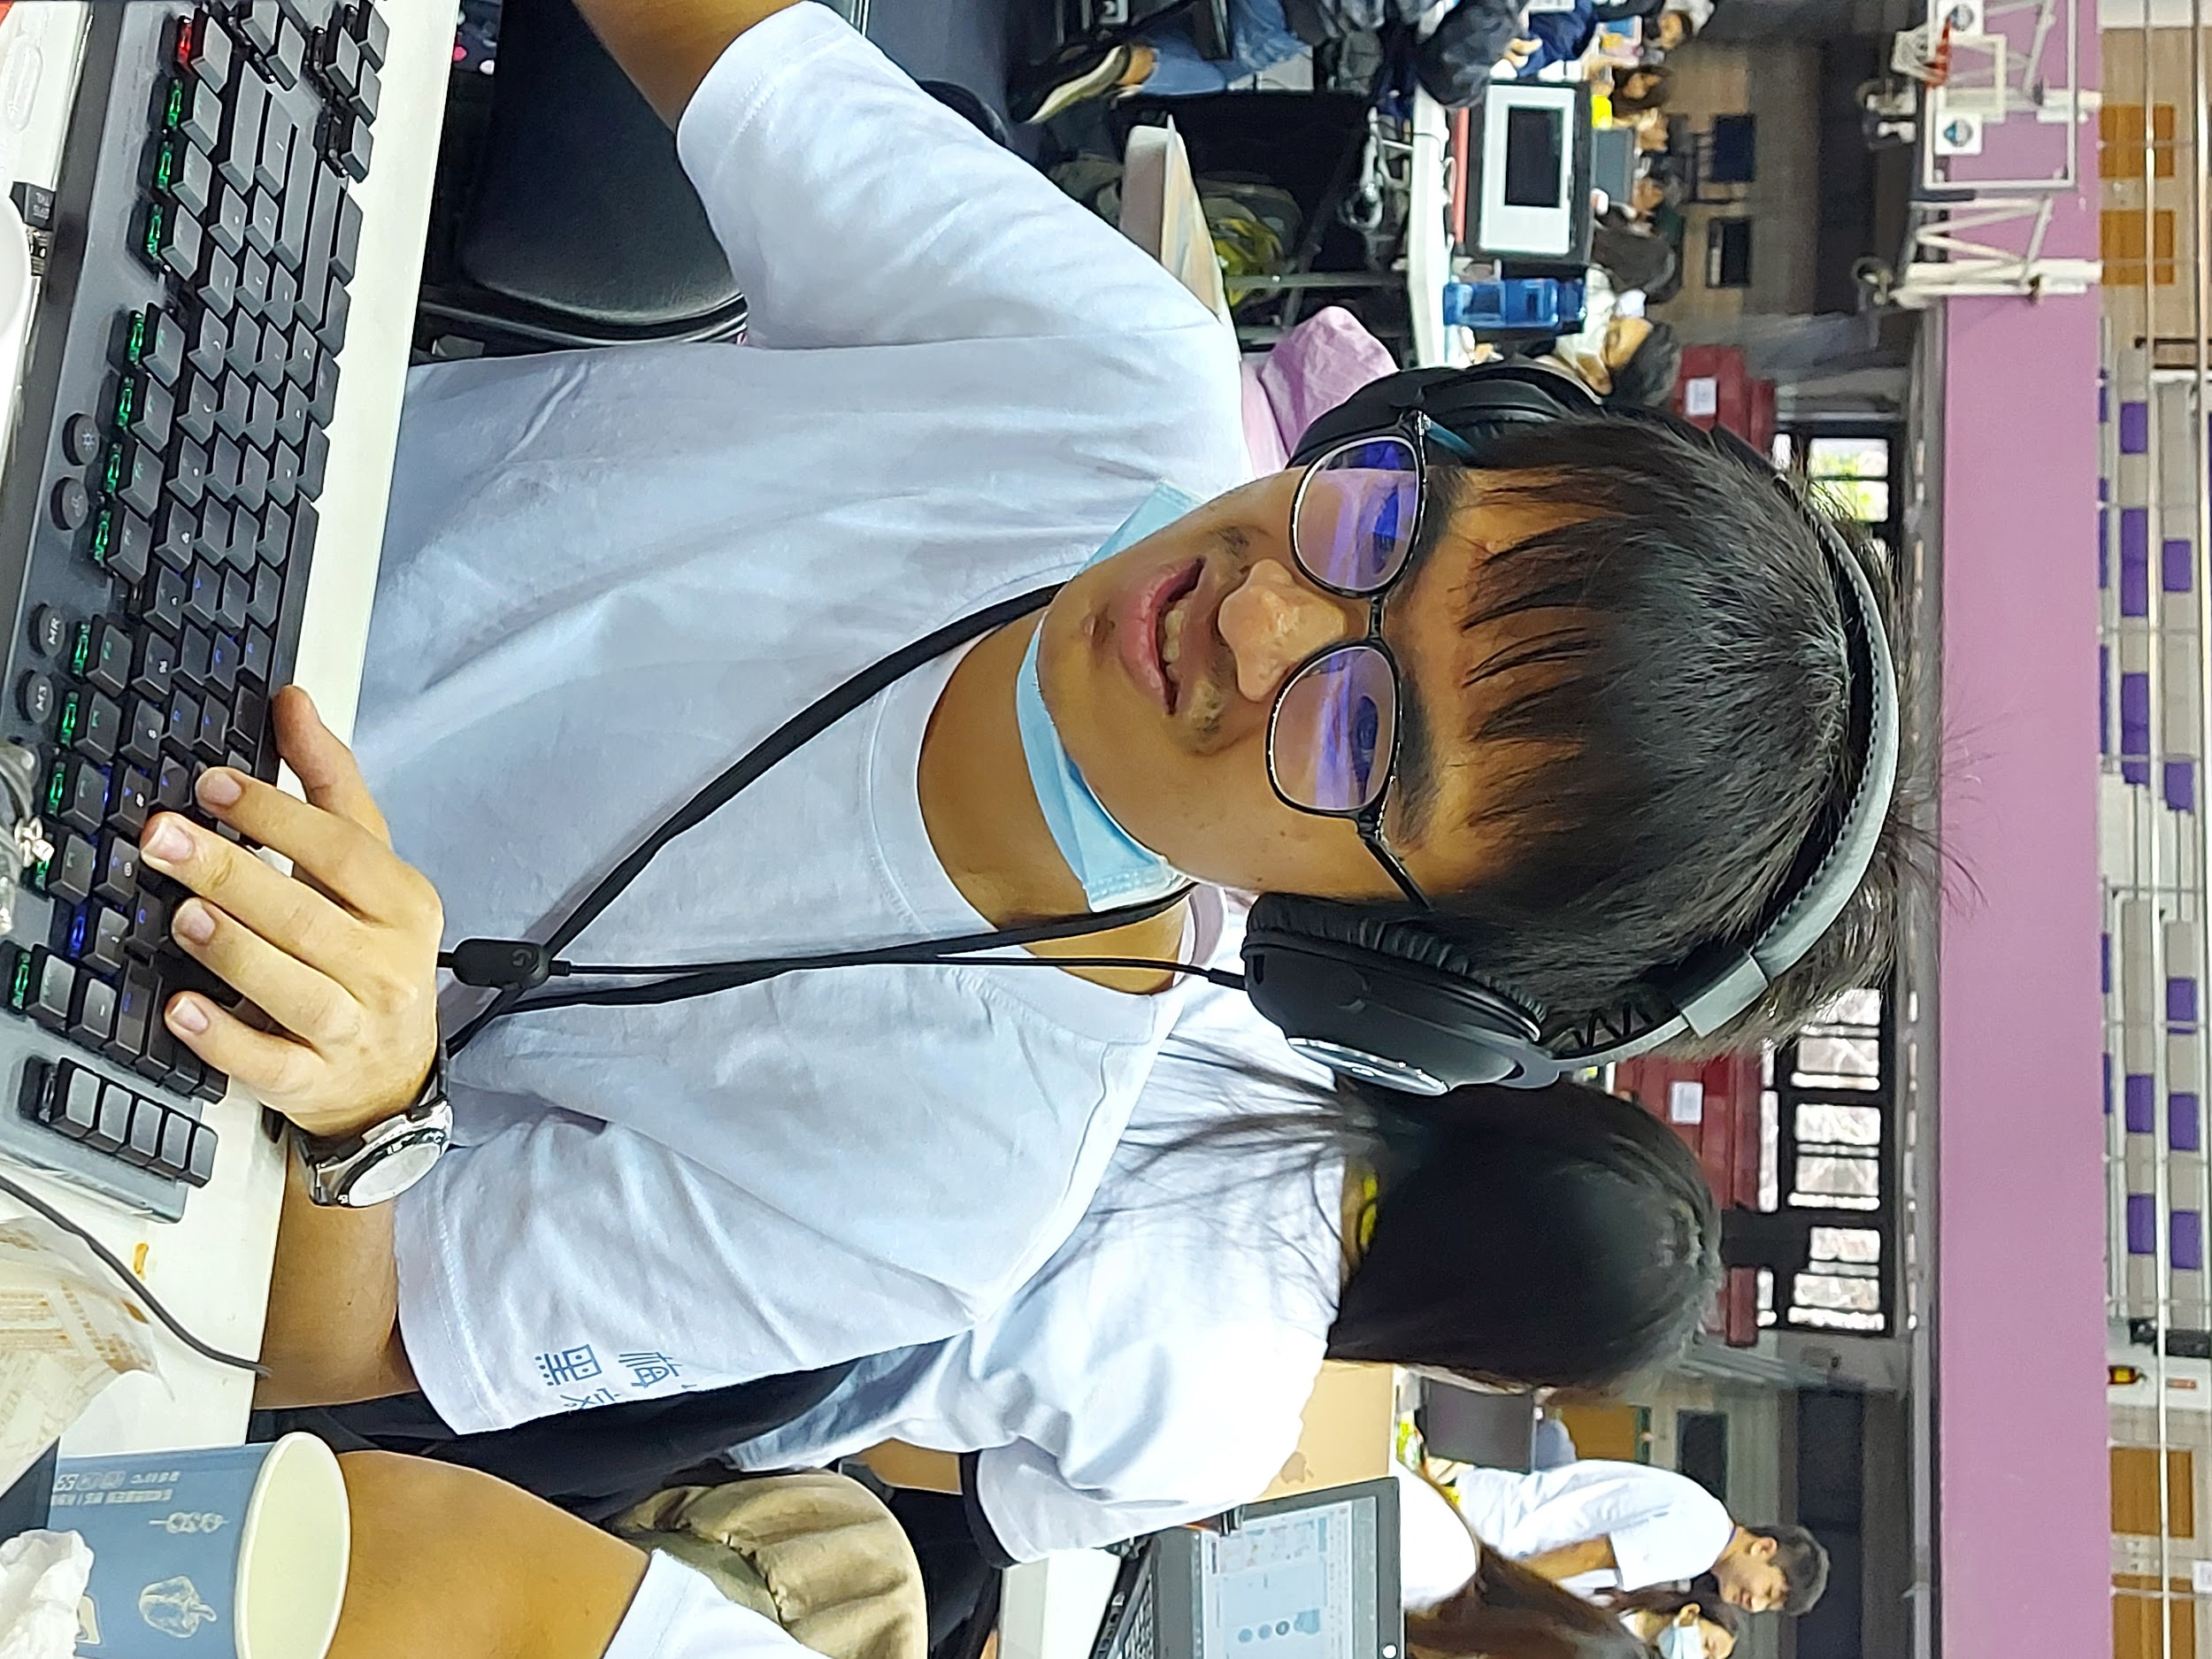
Result
Tester
+Hack
Model
Result
No
(69%)
No
(68%)
Yes
(53%)
No
(54%)

Slide 13
Prospect
Model Accuracy Enhancement
Co-operations with game developers
Game mode selection
Other hardwares (ex: mic)
Other applications of our model

Slide 14
Reference
“Intrusion Detection Using Mouse Dynamics” M Antal Et Al. 2018
BALABIT MOUSE CHALLENGE DATA SET - https://reurl.cc/pypQjl
Osiris - https://reurl.cc/Ld29rX

